Slide 1
Symphony of the Scriptures
Judges

Slide 2
Judges
shaphat <199> means “to pronounce sentence (for or against)” - in the broader sense has to do with ruling and leadership.
Samuel 1075 B.C.
about 300 years
1086-1004 BC
Causes of Course of Failure Curses
Failure from Failure
(1:1-2:5)
Joshua 1375 B.C.
Mesopotamia
40 yrs (3:9-11)
OTHNIEL
Canaan
20 yrs (4:4-5:31)
DEBORAH
BARAK
Abimelech 3 yrs (10:1-5)
TOLA JAIR
Philisitnes
40 yrs (13:2-16:3)
SAMSON
-20 yrs
Idolatry
Immorailty
Anacrhy
Idolatry
(2:6-3:4)
Moabites
18 yrs (3:15-30)
EHUD
Midianites
7 yrs (6:11-8:28) GIDEON
ELON (12:11-12) IBZAN (12:8-10)
ABDON (12:13-15)
Ammonites
18 yrs (11:1-12:7) JEPHTHAH
Intermarriage
(3:5-6)
SHAMGAR (3:31)
4- Deliverance & Rest
Micah (family) (17)
Danites (tribe) (18)
Levite /concubine (19) (
Civil War (20)
Mourning (21)
Defeat (1)
Review (2)
Chapters 1-2
1-Disobedience
2- Bondage
Cycles of Misery
5- Compromise
3- Misery
Chapters 3-16
Chapters 17-21
Defeat
Disobedience
Disgrace
Theme
Compromise brings failure
Key Verses
17:6; 21:25: “In those days there was no king in Israel; everyone did what was right in his own eyes”
Christ in Judges
Prefigured as the ultimate judge and deliverer
Notes:
The title “judge” makes us think of someone who determines guilt or innocence in a court case. But the Hebrew word here is shaphat <199> which means “to pronounce sentence (for or against)” and in the broader sense has to do with ruling and leadership In the broader since, it means to lead or rule. I have found that people are frequently interested in salvation but care nothing at all about the idea of obedience. The book of Judges is all about that. We want God’s mercy but protest His judgment. There is a stark contrast between the moods of the books of Joshua and Judges. The symphony is sweet and pure as Joshua closes. Listen to the melody: “Israel served the Lord all the days of Joshua, and all the days of the elders who outlived Joshua and had known all the work that the Lord did for Israel” (Josh. 24:31). On the other hand, Judges begins and ends with bitter notes: “And all that generation also were gathered to their fathers. And there arose another generation after them who did not know the Lord or the work that he had done for Israel…and everyone did what was right in their own eyes ” (Josh. 2:10-12; 21:25). What happened? The period of the Judges lasted somewhere around 350 years and during that time the failure of the people to complete their promise to destroy the inhabitants of Canaan leads to intermarriage, idolatry, and separation from God (1:3-6). Their failure through compromise causes them one by one, tribe by tribe, region by region, leads to rebellion against God. The second section of the Book provides seven cycles of misery for the Israelites (3:7-16:31). If the Israelites served God as they promised, all went well. If they turned to the idols of the Canaanites, God would allow an enemy to oppress them. The Israelites would call for help and He would raise a judge to deliver or fight the enemy. Then, the cycle would start again. The judges include Othneil (3:7-11), Ehud (3:12-30), Shamgar (3:31), Deborah (4-5), Gideon (6-8), Tola , (10-12), Jair (10:3-5), Jephthah (10:6-12:7), Izbar (12:8-10), Elon (12:11-12), Abdon (12:13-15), and Sampson (13-16). Later Eli and Samuel will be studied as the last judges. Some of the more well-known judges (like Gideon and Samson) get several chapters in the Book of Judges. Others only get a paragraph. Shamgar gets a single verse. The Book ends with examples of how far the people had fallen: first, there is the thievery of 1100 pieces of silver from his mother by Micah and its return and the 200 pieces used to build an idol (17:1-6); the corruption of a Levite priest who sells his service to the highest bidder (17:7-11), the slaughter of the town of Laish (18:7 ff.), the gang rape of a Levite’s concubine (chapter 19), the subsequent civil war against the tribe of Benjamin for not dealing with the men who committed the crime, the slaughter of the people of Jabesh-Gilead and the kidnapping of 400 virgins from that city. Judges may be ancient history, but human nature is still the same (see application points).
Application:
Watch it! Depravity results in permissiveness when righteousness is ignored. The media gives regular testimony to this.
Watch it! Permissiveness leads to rationalism when holiness is ignored. Sin seems to get redefined when holiness is ignored.
Watch it! Rationalism encourages rebellion when repentance is ignored. Personal responsibility vanishes when wrong gets massaged into right.
Key thought: Ignore righteous living and it won’t be long before we feel right about doing wrong. The Israelites looked to their own selves for the answers. Be careful whom you hang with.

Slide 3
Period | History Covered | Scriptures | Years | Principal
Antediluvian | Creation to the Flood | Gen. 1-7 | 1656 | Adam
Postdiluvian | From the flood to call of Abraham | Gen. 8-!1 | 427 | Noah
Patriarchal | From the call of Abraham to Egyptian Bondage | Gen. 12-45 | 215 | Abraham
Egyptian Bondage | From Egyptian Bondage to the Exodus | Gen. 46-Ex. 11 | 215 | Joseph
Wilderness Wanderings | From Exodus to crossing of the Jordan | Ex. 12-Deut. 34 | 40 | Moses
Conquest of Canaan | From crossing of Jordan to Joshua’s death | Josh. 1-24 | 51 | Joshua
Judges | From Joshua to King Saul | Ju, Ruth, 1 Sa. 1-9 | 305 | Samuel
The United Kingdom | From origin of kingdom to its division | 1 Sa. 9-1 Ki. 11; 1 Chr. 10, 2 Chr. 9 | 120 | David
The Divided Kingdom | From the division to the fall of Israel | 1 Ki. 12-2 Ki. 20; 2 Chr. 10-32 | 253 | Elijah
Judah Alone | From fall of Israel to the fall of Judah | 2 Ki. 21-25; 2 Chr. 10-32 | 125 | Josiah
Babylonian Captivity | From the fall of Judah to the return | 2 Ki. 25-8- 21; Dan. 1-6 | 70 | Daniel
Restoration of the Jews | From the return to end of OT history | Ezra, Nehemiah | 92 | Ezra
Between the Testaments | From end of OT to the beginning of the NT | None | 400 | Judas Maccabe
Life of Christ | From birth of Jesus to ascension | Mt-Jhn 21; Acts1 | 34 | Jesus
The Church | From ascension to death of Paul (96 AD approx.) | Acts 2-Revelation | 70 | Paul

Slide 4
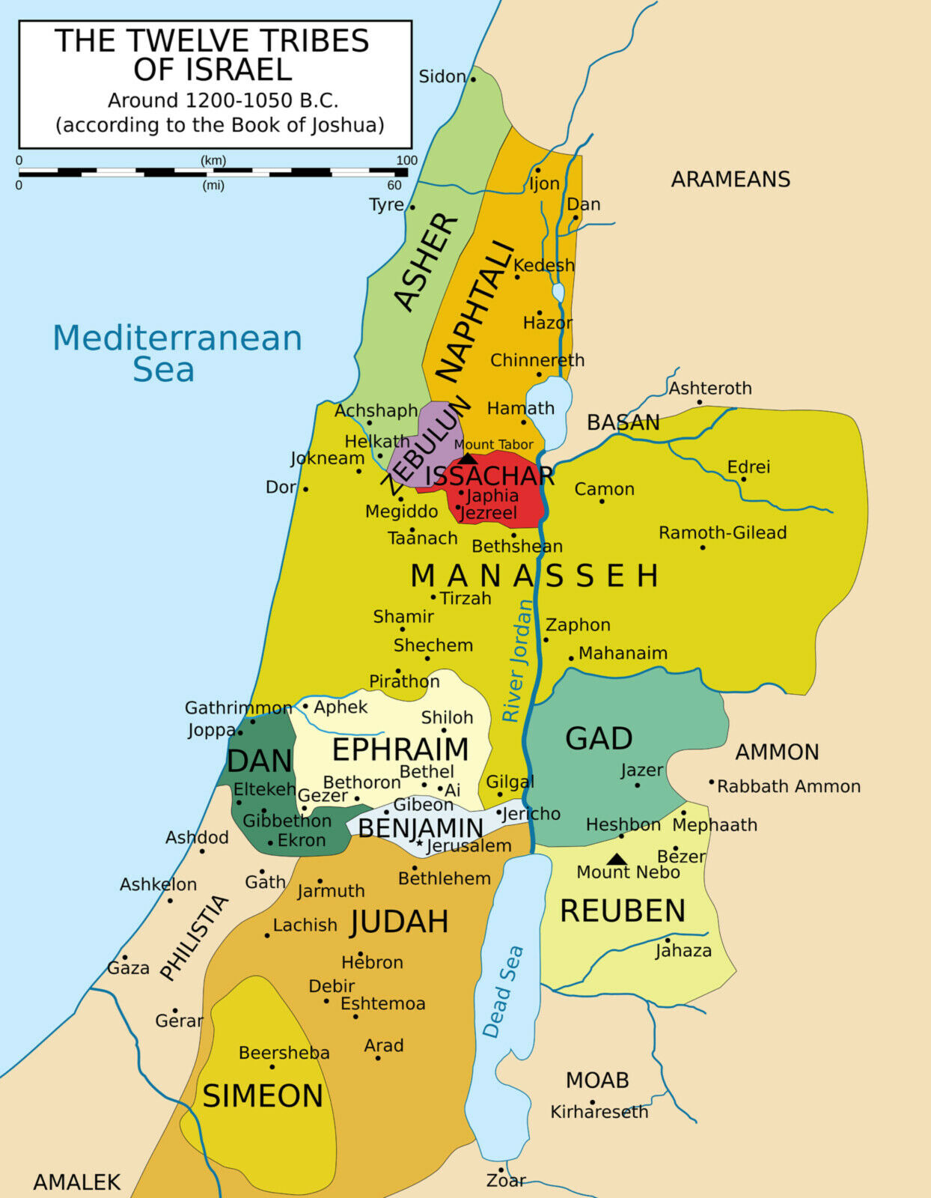

Slide 5
Introduction
”Politically and militarily, there is a need for a complete conquest of the promised land. Spiritually, there is still a great lesson for a new generation of Israelites to learn---namely, that with obedience comes prosperity, with disobedience, adversity. It is a lesson the older Israelites had learned through the wilderness wanderings and the initial conquest of Canaan, but the passing of the older generation leaves a vacuum of any real dedication to God or his laws. From this point forward, Israel heads into both spiritual and political decline…A strong spirit of compromise leads to intermarriage, idolatry, and immorality. The combination of national sin and unconquered inhabitants results in dominance and oppression by various pagan peoples, just as God predicted. During this time the Israelites go through repeated cycles of sin an oppression, but fortunatel, of repentance also. And for each time the people came to their senses God raises up a leader (judges) to deliver them.” --- F. LeGard Smith, The Narrated Bible, page 346-347.

Slide 6
Recycled Misery…
Final words of Joshua
Beginning Words of Judges
“Israel served the Lord all the days of Joshua, and all the days of the elders who outlived Joshua and had known all the work that the Lord did for Israel” (Josh. 24:31)
“And all that generation also were gathered to their fathers. And there arose another generation after them who did not know the Lord or the work that he had done for Israel. ¹¹ And the people of Israel did what was evil in the sight of the Lord and served the Baals” (Ju. 2:10-11)

Slide 7
Recycled Misery…What Happened?
“The book of Judges relates the stories of a number of leaders called “Judges.” Each story follows the same pattern. It may be called history repeating itself in four stages or steps: (1) The people of God doing evil. (2) Jehovah sending an oppressor to persecute and enslave them. (3) The people in distress praying fro deliverance. (4) God raising up a Judge or deliverer to defeat the enemy and deliver the people.” -- Hester, p. 155
From bondage to spiritual faith
From spiritual faith to great courage
From great courage to liberty
From liberty to abundance
From abundance to leisure
From leisure to selfishness
From selfishness to complacency
From complacency to apathy
From apathy to dependency
From dependency to weakness
From weakness back to bondage

Slide 8
The function of judges
“The chief function of these Judges was to serve as military leaders to deliver the people from their oppression. In some cases they continued as statesmen or political and judicial leaders after the crisis was past. In some cases they served as religious leaders. In most cases these Judges seem to have passed off the stage shortly after the crisis was over. It should be remembered that these Judges are not represented as men of ideal character…” --- Hester, p. 155 .
Notes:
For example, Jephthah, was an illegitimate son who was crude, barbaric, and made unwise oaths. Sampson was weak in religious ideals and moral character.

Slide 9
Failure through compromise
Joshua
judges
Joy and achievement
Strength
Victory
Unity and order
Freedom
Obedience
Conquering
Zeal
Consecration
Sorrow and failure
Weakness
Defeat
Disunity and anarchy
Bondage
Disobedience
Maintaining
Indifference
Degradation

Slide 10
A Look at the judges
Othniel (3:7-11): Caleb’s nephew and Israel’s first judge. He served not long after Joshua’s death. He saved his people after eight years of oppression under the kingdom of Aram. During his reign the kingdom had peace for forty years.
Ehud (3:12-30): A left handed man and a Benjamite, he delivered Israel from eighteen years of servitude to Eglon, the king of Moab who had especially oppressed the tribes east of the Jordan. After going to Moab and asking for an interview he stabs the king, locks him in his room and leaves him for dead. He quickly forms an army and defeats Moab who is in disaaray. Ehud’s legacy was thirty years of peace for his people.
Shamgar (3:31): Only one verse dedicated to him but we know he killed 600 Philistines single-handedly with an oxgoad.
Deborah (Chapters 4-5): The only woman judge (and a prophetess), she went into battle alongside Barak - a warrior who would only go into combat if she would go with him. She delivered her people from twenty years of Canaanite oppression whose King was Jabin. Her triumph, and that of Jael, the woman who killed the enemy commander (Sierra) driving a tent pin through his head while he slept, is commemorated in a song (chapter 5). Deborah provided peace for forty years.

Slide 11
A Look at the judges
Gideon (Chapters 6-8): From the tribe of Manasseh, he is probably best remembered for testing the Lord with the sign of the fleece - the first requested that the fleece be wet and the ground dry, then the fleece would be dry and the ground wet. God obliges him and provides a 300 hundred man army, reduced by God from the original 32,000, to rout the Midianites (and other Arab tribes), who had oppressed Israel for seven years. After his victory the people, wanting to make him their king, were rejected by Gideon (8:23).
Tola (10:1-2): Following Abimelech’s reign of terror (he was Gideon’s son), he saved his people and served for twenty-three years.
Jair (10:3-5): Known for having “thirty sons who rode on thirty donkeys” - probably a sign oif wealth - he judged fro twenty-two years.
Jephthah (10:6-12:7): An illegitimate son cast out of his father’s family, he was called back by his townspeople to rescue them from the Philistines and Ammonites --- who had oppressed God’s people for eighteen years. A foolish (and uneccessary) vow on his part impacts his daughter, and foolish pride on the part of the Ephraimites cost them 42,000 men at Jephthah’s army’s hands. He judged only six years.

Slide 12
A Look at the judges
Ibzan (12:8-10): A judge of Israel for seven years - known for having thirty sons and thirty daughters.
Elon (12:11-12): from the tribe of Zebulon, judged Israel for ten years.
Abdon (12:13-15): Another wealthy man, he judged Israel eight years and had forty sons and thirty grandsons who has seventy donkeys” (12:14).
Sampson (chapters 13-16): The last, and the most well known of all the judges. More is written of him than any others. Set apart at birth (Nazarite vow) He led his people from Philistine oppression that had went on for twenty years, but unfortunately is more known for his selfishness and lust that led to indiscriminate sharing and his loss of strength.

Slide 13
Who wrote the book?
The text of Judges gives no indication as to who wrote the book, but Jewish tradition names the prophet Samuel as the author. The namesake of 1 and 2 Samuel, Samuel was the last of the judges, one of the special leaders whom God raised up during this time period to rescue His people. The judges did not oversee merely legal matters, as in our sense of the role; their tasks often included military and administrative authority as well.
Why Samuel? The author of Judges certainly lived in the early days of the monarchy. The recurring statement, “in those days there was no king in Israel” (Judges 17:6; 18:1; 19:1; 21:25), points out a contrast between the events happening in the book and the time of its writing. Clues within Judges suggest it was written before David established his throne in Jerusalem (1004 BC), yet after Saul was anointed king (1051 BC) (compare Judges 1:21 with 2 Samuel 5:6–7 and Judges 1:29 with 1 Kings 9:16). Also, Samuel was known to write on occasion (1 Samuel 10:25).

Slide 14
Where are we?
We think about the judges as both a period of time and a book of the Bible. The period of the judges began after the death of Joshua in the early fourteenth century BC (Joshua 24:29) and continued until Saul was crowned king of Israel by the prophet Samuel in 1051 BC (1 Ss 10:24). The book of Judges acts as the sequel to the book of Joshua, linked by comparable accounts of Joshua’s death (Joshua 24:29–31; Judges 2:6–9). Events within the book of Judges span the geographical breadth of the nation, happening in a variety of cities, towns, and battlefields. Scholars believe some of the judges ruled simultaneously in separate geographical regions. Attempts to calculate the exact amount of time covered in Judges are inconclusive, but generally, the book begins soon after the death of Joshua and ends in the years just before the entrance of Samuel onto the scene, a period of over three hundred years.
The contents of Judges were likely not written chronologically. The final few chapters (Ju. 17–21) give an overview of the moral climate during those days and, rather than occurring after the period of the judges listed earlier in the book, they probably happened in and around the times of various judges mentioned in earlier chapters.

Slide 15
Why is Judges so important?
The time of the judges brought about great apostasy in Israel. The nation underwent political and religious turmoil as the people tried to possess those parts of the land that had not yet been fully conquered. The tribes fought among themselves, as well, nearly wiping out the tribes of Manasseh (Judges 12) and Benjamin (20–21). The pattern of behavior in the book of Judges is clear: the people rebelled through idolatry and disbelief, God brought judgment through foreign oppression, God raised up a deliverer—or judge, and the people repented and turned back to God. When the people fell back into sin, the cycle started over again.
Ironically, in this book we meet many heroes of faith: Othniel, Gideon, Samson, Shamgar, Deborah, Jephthah, Ehud . . . flawed individuals who answered God’s call to deliver the Israelites in sometimes dramatic form. The book includes many of the most graphic, violent, and disturbing scenes in all Scripture—some in the name of righteousness, others in the name of evil.

Slide 16
What's the point?
The primary message of Judges is that God will not allow sin to go unpunished. As Exodus established, Israel was God’s people—He was their King. They had forsaken the covenant established at Mount Sinai. In Judges, He disciplined them for following other gods, disobeying His sacrificial laws, engaging in blatant immorality, and descending into anarchy at times. Yet because they were His people, He listened to their cries for mercy and raised up leaders to deliver them. Unfortunately, even these godly individuals did not wield sufficient influence to change the nation’s direction. The people’s inability to resist sinful Canaanite influences eventually revealed their desire for a centralized monarchy, led by a righteous king whom God would choose as His intermediary.

Slide 17
How do I apply this?
Memory is a gift. Remembering the past teaches us countless lessons about how to live today. The Israelites forgot. They did not remember the miraculous events that brought them to their land or the covenant that united them to their God. But God did not forget His covenant—and because of His great love for His people, He disciplined His sinful children so that they might return to Him.
Have you forgotten the great works God has done in your life? Perhaps your difficult circumstances are overpowering your faith. Do you feel as if He is disciplining you right now? Know that He disciplines those He loves (Hebrews 12:5–11). Return to Him. Remember, trust, and obey. He is waiting with open arms.

Slide 18
Brief Outline
I. Introduction to era of the judges, Chapters 1, 2
A. Condition of nation after death of Joshua (1)
B. Israel’s cycle in period of the judges: “And the children of Israel did evil in the sight of the Lord” (2)
II. Era of the judges, Chapters 3-16
A. 1st Apostasy; conquered by Mesopotamia; delivered through Othniel (3:1-11)
B. 2nd Apostasy; conquered by Moabites and Philistines; delivered through Ehud and Shamgar (3:12-31)
C. 3rd Apostasy; conquered by Jabin, king of Canaan; delivered through Deborah and Barak (4:1-5:31)
D. 4th Apostasy; conquered by Midian; delivered through Gideon (6:1-8:32)
E. 5th Apostasy; civil war; delivered through Abimelech, Tola, Jair (8:33-10:5)
F. 6th Apostasy; conquered by Philistines and Ammonites; delivered through Jephthah, Ibzan, Elon, Abdon (10:6-12:15)
G. 7th Apostasy; conquered by Philistines; delivered partially through Samson (13-16)
III. Results of era of the judges (confusion), Chapters 17-21
A. Religious apostasy (the temple) (17, 18)
B. Moral awfulness (the home) (19)
C. Political anarchy (the state), (20, 21)

Slide 19
Period of Judges Summarized
“It seems that Israel’s moral decline has so affected the people that even honest attempts at goodness are blemished. Even in the sincere efforts made to forgive and to restore the Benjamites, there is an inclination that the Israelites have exercised extremely questionable moral judgment as far as their methods were concerned. This entire period of the Canaan conflict is a sad testimony to the relationship between God and man. From a pinnacle of adherence to law under Moses (as imperfect as their obedience was, even then), the nation of Israel has sunk to a new low ebb in which moral authority is no higher than self-will. The inspired record sums it up with a disappointing epitaph: “In those days there was no king in Israel, and every man did whatever was right in his own eyes” (Ju. 21:25). --- F. LeGard Smith, The Narrated Bible, page 383

